Slide 1
RailWAY Friction Management

Slide 2
Globally leading technology
protected with over 30 patents
RAILWAY FRICTION NOISE
RAIL & WHEEL WEAR
RAIL &WHEEL VIBRATIONS
Pioneering technology in rail friction noise management since 1991.

Slide 3
Award-winning technology
European Business Award for the Environment in 2004 by the European Commission.
Research and innovations award in 2012 and 2014 by the International Union of Railways.
Seal of Excellence by the European Commission in 2019.

Slide 4
Major benefits
Up to 99% reduction of rail friction noise.
Over 300% extention of rail lifetime in curves and adequate wheel lifetime extention.
Reduced vibrations positively affect rolling stock (e.g. bearings) & infrastructure (e.g. ballast subsidience).

Slide 5
Composite Hardly-Fluid Compounds (CHFC)
IMPORTANT: It is the composite materials that provide the anti-noise, anti-wear & anti-vibration results. Devices „only“ enable precise and reliable application!
NLGI grade 2; more than 40% solid particles, highest percent on the market.
Balanced selection of anti-noise, anti-wear & anti-vibration additives.
CHFC are a high-performing replacement for standard mineral-oil-based lubricants.
Developed to withstand high load pressures.

Slide 6
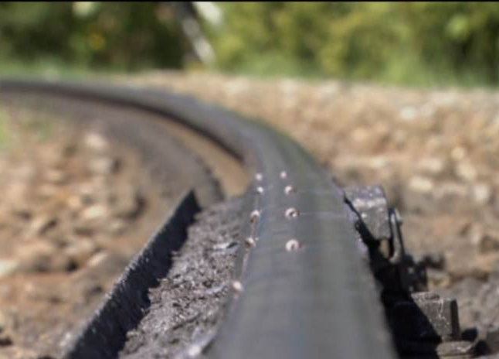
Composite Hardly-Fluid Compounds (CHFC)
Expect very low consumption!
Dedicated types of CHFCs for different applications: trackside, on-board, marshalling yards.
Environmentally friendly, do not bioaccumulate, non-corrosive, do not interfere with conductivity.
Reduce high frequency noise and other friction phenomena: gauge wear, gauge corner cracking (GCC), rolling contact fatigue (RCF), corrugation (sinus line) and corresponding negative phenomena on wheels.

Slide 7
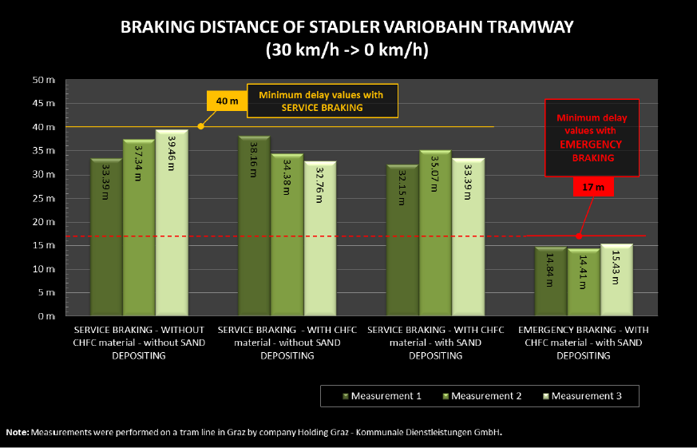
Safety first: braking distances are not compromised!
CHFCs are the only materials that can simultaneously be applied on top of rail (TOR) and rail gauge – complete protection of rails and wheels.
Competitive technologies run risk of flange lubricants getting transfered on top of rail and thus compromising required traction on TOR.
CHFC is often the only solution for sloped railways.
In this particular case standardized braking distance and time was 4,3% shorter after CHFC application.

Slide 8
Highest safety levels
Results delivered also in rainy conditions: CHFC materials do not react with rain and consumption during rain is not increased.
Physical properties were attested by Deutsche Bahn on a large dynamometer (with very good results): CHFC fulfil tribological demands on all parts of the wheel-rail interface
Required friction coefficients maintained within frames accepted by the tribological science (µ ≈ 0,15 ÷ 0,25, provided steel/steel µ = 0,1 ÷ 0,3.)
Technology and management systems have been attested and verified by various independent bodies:

Slide 9
Rail Friction Noise reduction
Average RFN reduction at the measured curve was 18 dBA or 98,43 %.
Average RFN reduction
Source: Refer Portugal, 2012

Slide 10
Rail Friction Noise reduction
train,
metro,
tramway,
marshalling yard
Youtube recording of the results before/after implementing WONROS technology. The technology reduces RFN most convincingly where many other available technologies have failed.
Click to watch & listen.

Slide 11
Self financing technology
Over 300% higher lateral rail wear in a tramway curve before WONROS technology was introduced.
333%
300%

Slide 12
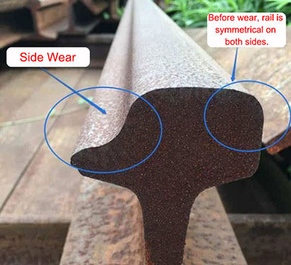
Lifecycle cost reduction
National railway infrastructure
Investment in trackside unit in a curve R=600 m.
Results:
Rail grinding/milling (1800 m) reduced: every 2-3 years instead of every year.
Rail replacement 100 m every 6 years instead of every 2 years
Net savings every year 10.900 €
Reduction of rail loss: 1.439 kg/year
Investment can be returned in cca. 2 years.
Rail is simetrical
on both sides
before wear
Side wear
Environmental aspect: Wear of rails emits heavy metals into the air and soil + CO2 emissions at producing steel.

Slide 13
Lifecycle cost reduction
Example: a city with 250.000 inhabitants
Tramway lines maintaining 25 trackside units (from competitor X)
Devices had to be maintained/refilled every 14 days
Consumption of lubricant was cca. 700 kg/year per device
After introducing CL-E1 devices + CHFC material: maintenance every 6 months – annual labour cost reduced by several times to 720 € per device.
CHFC consumption around 100-150 kg/year per device – refilling only required 2-3 times per year.

Slide 14
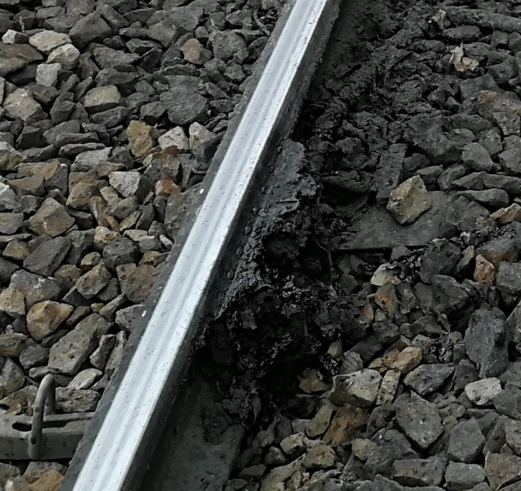
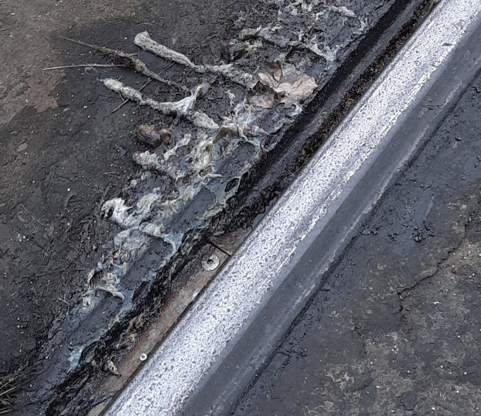
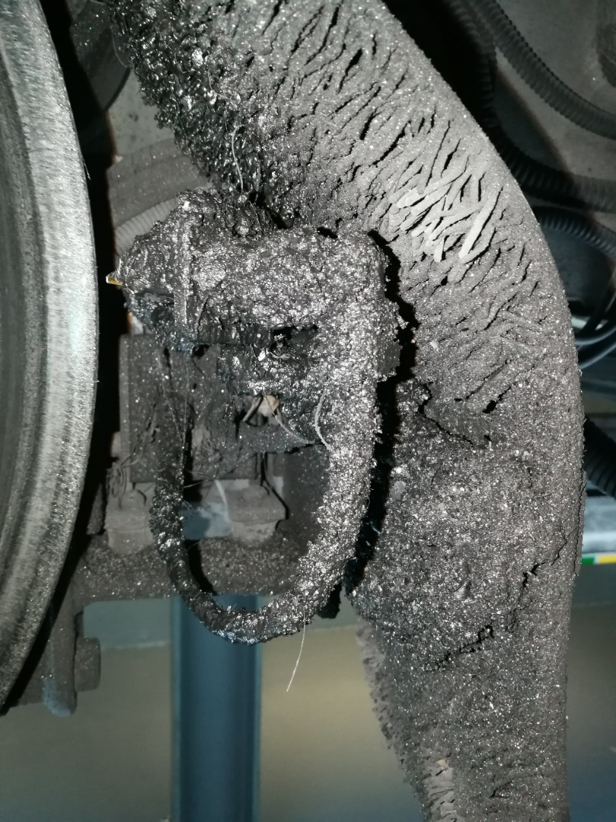
The lowest levels of soiling
WONROS technology (composite materials + devices) keeps tracksides and vehicles‘ bottoms unsoiled. CHFC materials do not drop or leak. Trackside devices have double „overdosing“ protection systems. It is the cleanest of all available technologies.

Slide 15
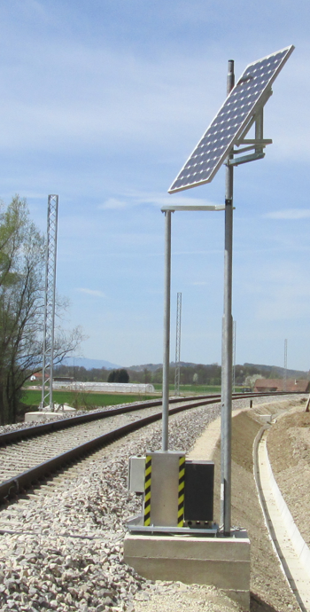
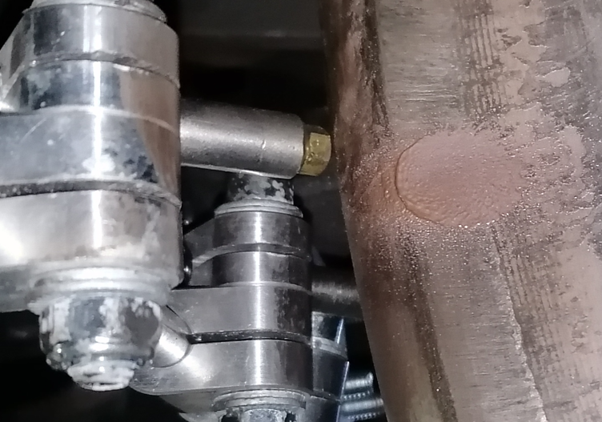
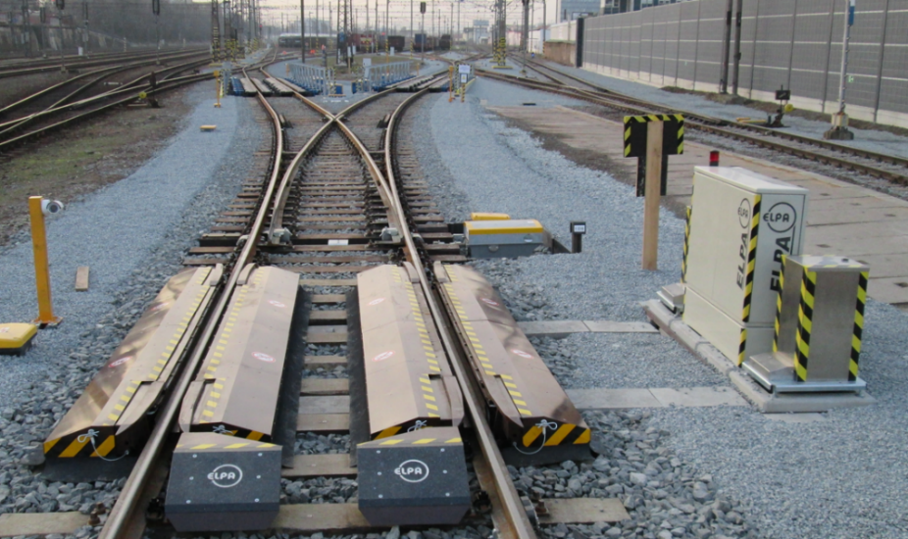
Scope of the technology
TRACKSIDE DEVICES
ON-BOARD DEVICES
MARSHALLING YARDS SYSTEMS

Slide 16
Scope of WONROSTM technology
TRACKSIDE
ON-BOARD
SUPPORTING DEVICES
CL-E1
Rail friction management device
i-ROCK
Spraying system with compressed air
FILLING STATIONS
For on-board and trackside devices
BREMEX ANNSYS
Anti-noise and wear system for hump yard retaders
DRYproANNSYS
Contact system w/o compressed air
SERVICING, INSTALLATION & RUNNING-IN DEVICES

Slide 17
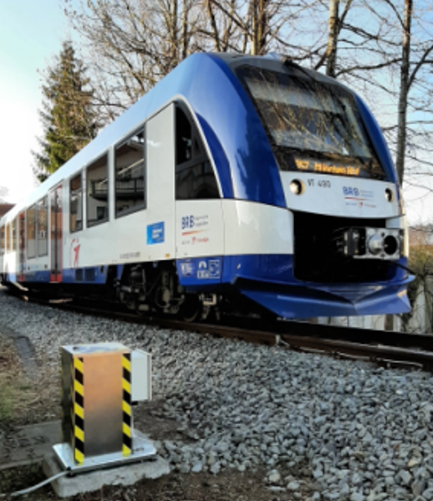
Trackside devices
WONROS trackside technology (6 min)
Low CHFC consumption – reservoir typically refilled 2-3 times per year.
Low maintenance costs servicing/maintenance once/twice per year.
Highly accurate application to all parts of the wheel-rail interface.

Slide 18
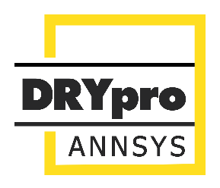
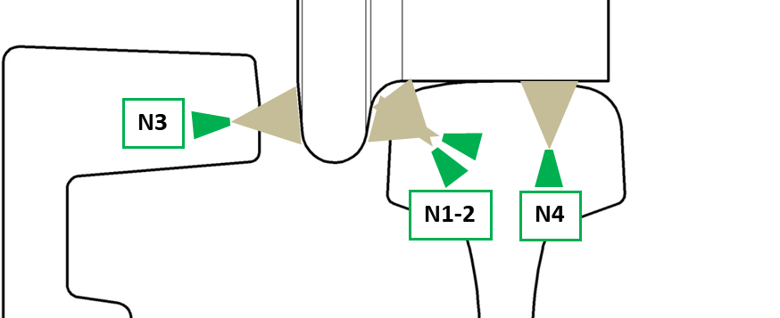
On-board devices
Complete conditioning (unique on the market) – all parts of the wheel are addressed:
CHFCs works both as top of rail friction modifier (TOR FM) and as wheel flange lubricant (WFL), and wheel flank lubricant.
Compressed air system (i-ROCK)
No compressed air system (DRYproANNSYS).
High precison applyication to chosen parts of the wheel.
Operation modes: curve mode, straigt track mode, stand-by mode.

Slide 19
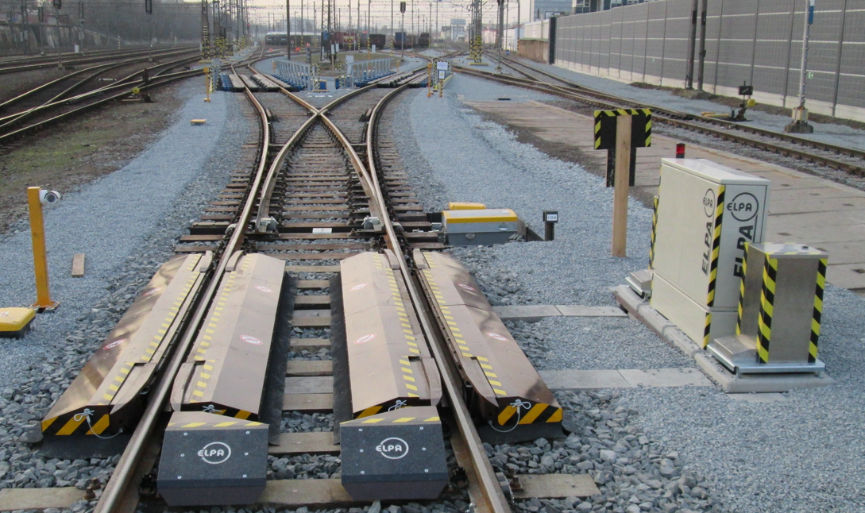
Marshalling yards
friction noise reduction
Bremex Annsys is a globally unique solution.
Efficient reduction of noise generated by trackside brakes.
Noise is reduced (eliminated) by up to 99,9% or 30 dBA.
Brakes wear is reduced by 8 times.
The only environmentally acceptable and efficient solution to solve problem of high frequency noise on hump yards. The squealing noise usually exceeds 130 dBA and is heard for many kilometers.

Slide 20
About the company
ELPA is a long-standing regular member at UNIFE.
ELPA‘s deputy is a member of the expert group of Railway supply industry at the European Commission.
First-tier supplier
to major infrastructure operators: SNCF, DB, Russian Railways...

Slide 21
About the company
Vision of the green future…
Sustainable and environmentally conscious mindset has always been at the core of the WONROSTM technology. Rail friction noise has been in its focus long before it came under the spotlights of wider public, railway sector and legislators.
Vision driven persistence in solving longstanding problem of RFN resulted in an advanced technology system that addresses all negative impacts of railway friction. Main mission is to distribute this large body of knowledge to global markets and contribute to environmentally friendly railways.

Slide 22
Railway friction management
Headquarters: ELPA Ltd, Environmental management and tribotechnology, Paka pri Velenju 39d, 3320 Velenje, Slovenia, Telephone: +386 3 898 63 30, Fax: +386 3 898 63 38, E-mail: info@elpa.si

